Slide 1
Multilevel Model Implementation
Gaojia Xu

Slide 2
Roadmap
Why do we use a Multilevel Model?
What is a Multilevel Model?
How to implement a Multilevel Model?

Slide 3
Roadmap
Why do we use a Multilevel Model?
What is a Multilevel Model?
How to implement a Multilevel Model?

Slide 4
Why do we use a Multilevel Model?
Recognize the existence of hierarchical or clustered structure in the dataset.
Balance between polling and non-pooling models.
Share of information between estimates.
Allows partition of residual variance, quantification of group effects.

Slide 5
Roadmap
Why do we use a Multilevel Model?
What is a Multilevel Model?
How to implement a Multilevel Model?

Slide 6


What is a Multilevel Model?
Also known as random effects model, hierarchical model, linear mixed-effect model, etc.

Slide 7
Roadmap
Why do we use a Multilevel Model?
What is a Multilevel Model?
How to implement a Multilevel Model?

Slide 8
How to implement a Multilevel Model in R?
Background
EDA
Model Selection
Model Results
Model Assessment

Slide 9
How to implement a Multilevel Model?
Background
EDA
Model Selection
Model Results
Model Assessment and Limitation

Slide 10
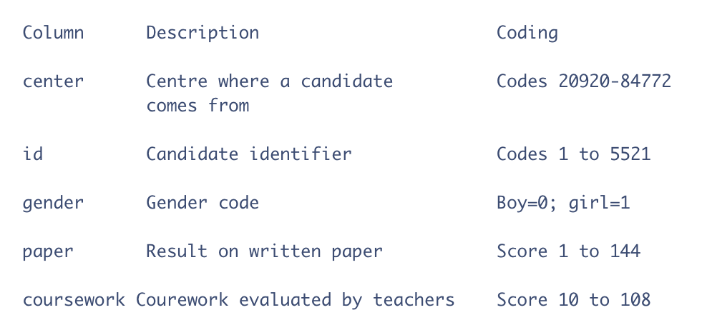
Background
Dataset comes from The Associated Examining Board in Guildford.

Slide 11
Background
Research Questions:
1. Examine the variability of paper grades across centers.
2. How is the coursework evaluation by professors relate to paper grade?
3. Whether gender of the student is associated with paper grade?

Slide 12
EDA
Dataset comes from The Associated Examining Board in Guildford.

Slide 13
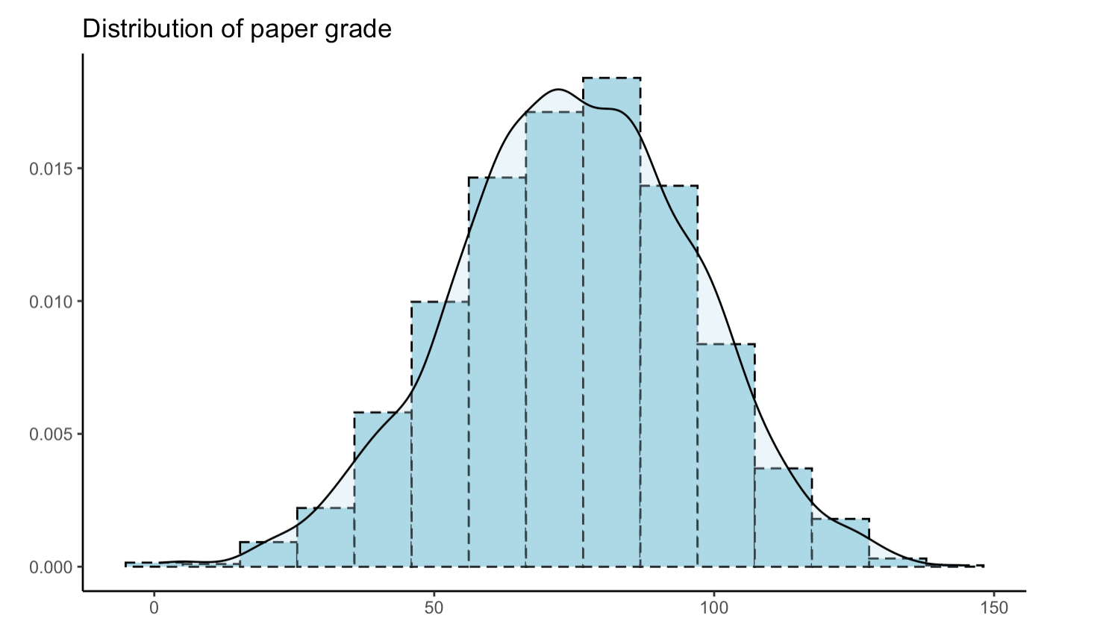
EDA: paper

Slide 14
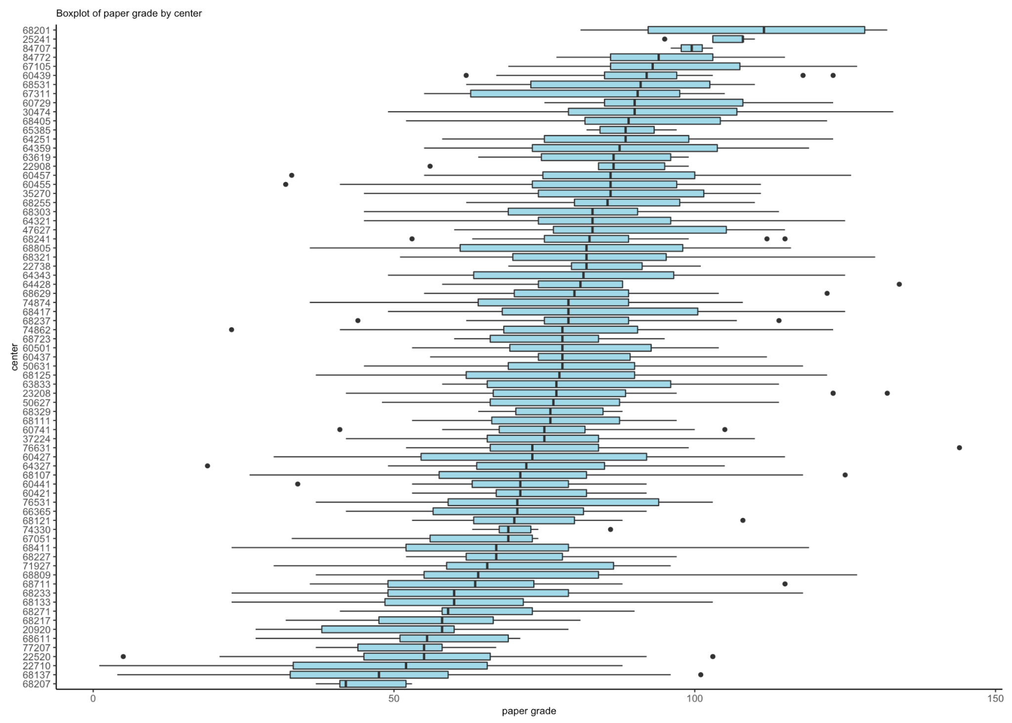
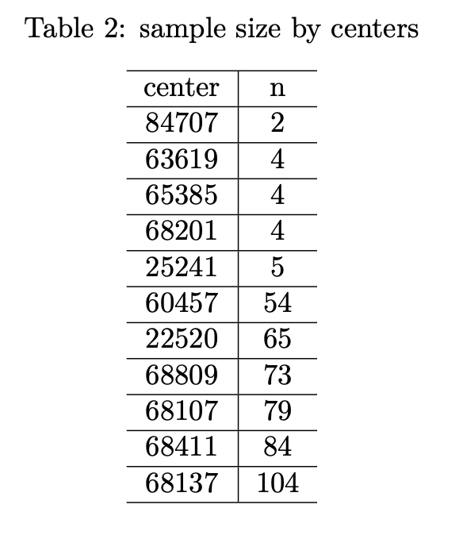
EDA: center

Slide 15
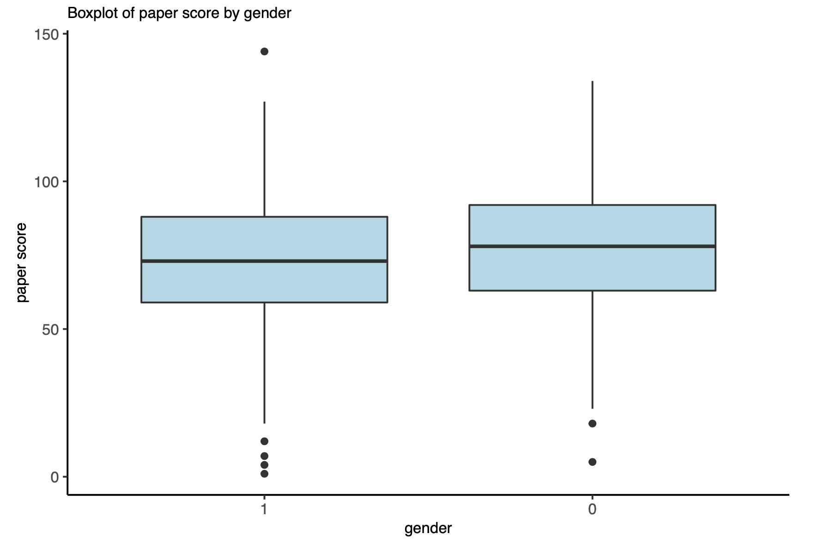
EDA: gender

Slide 16
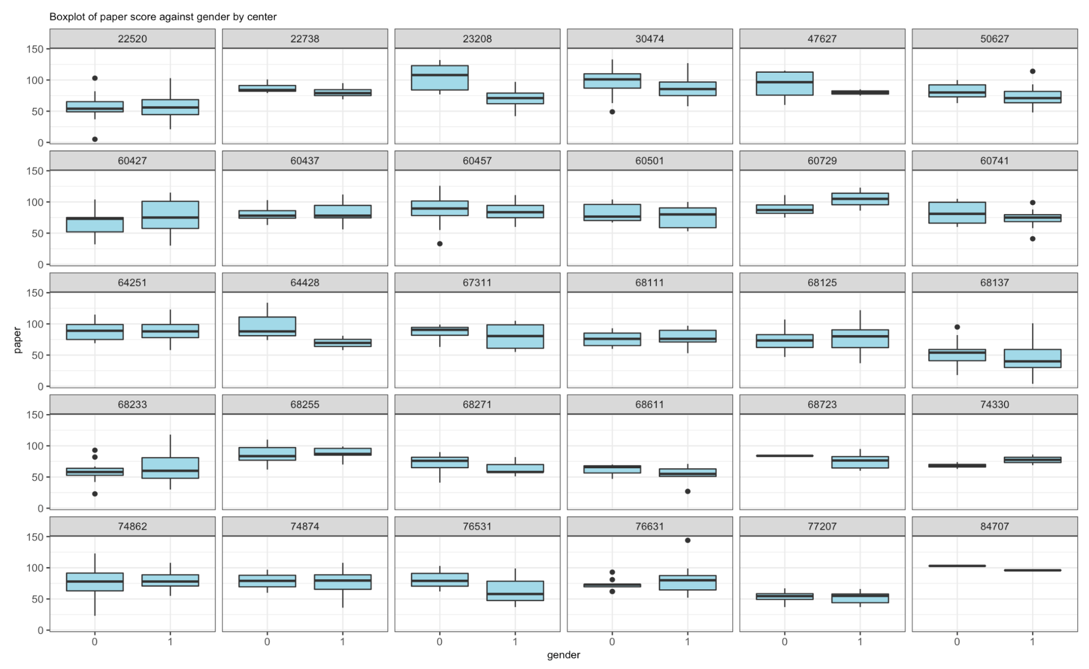
EDA: gender and center

Slide 17
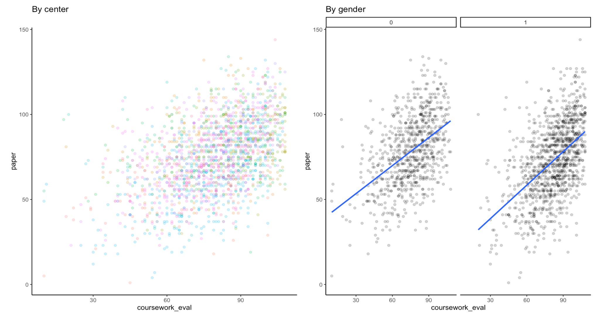
EDA: coursework_eval

Slide 18
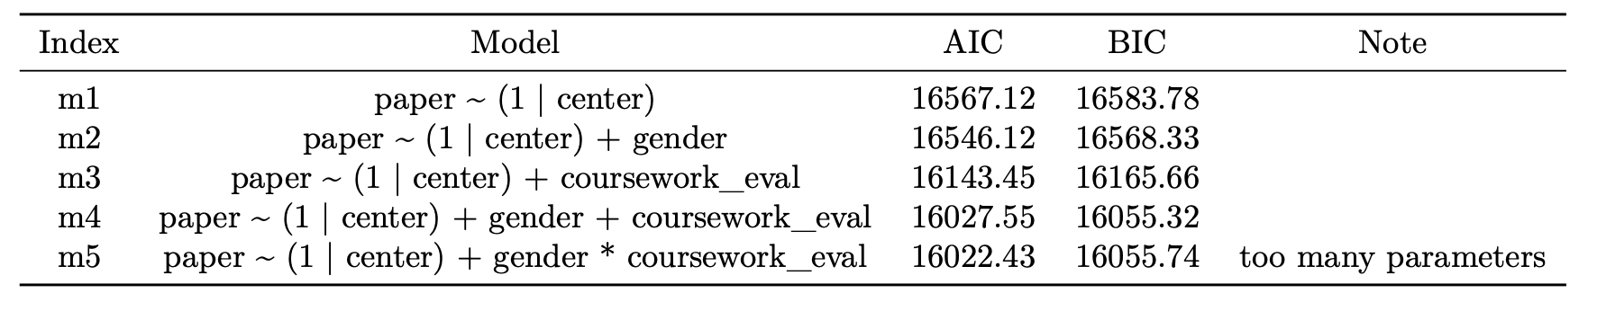
Model Selection

Slide 19
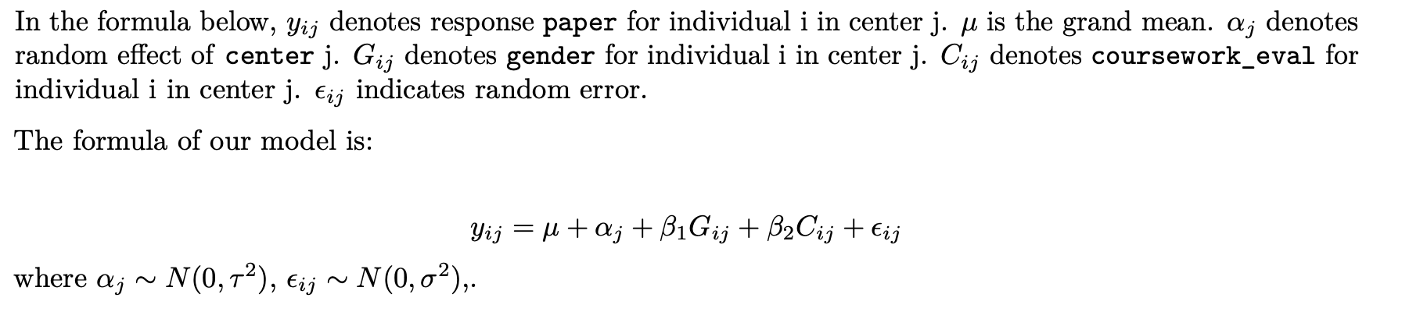
Model Selection

Slide 20
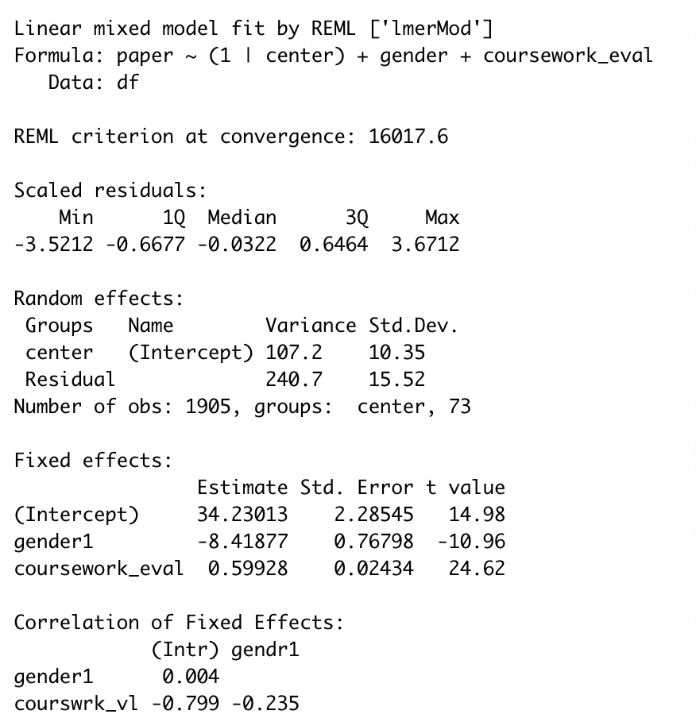
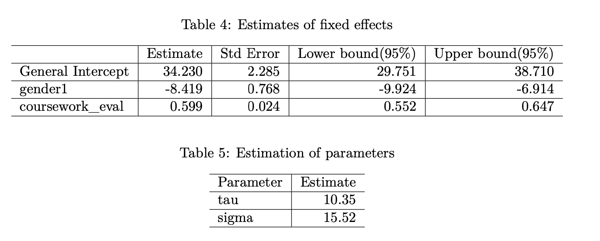
Model Results

Slide 21
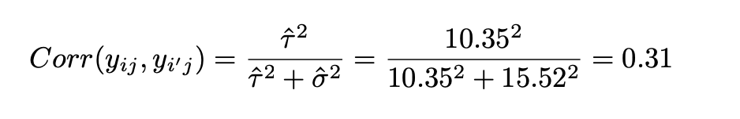
Model Results
Correlation between two individuals in the same center by using estimations in last slide:

Slide 22
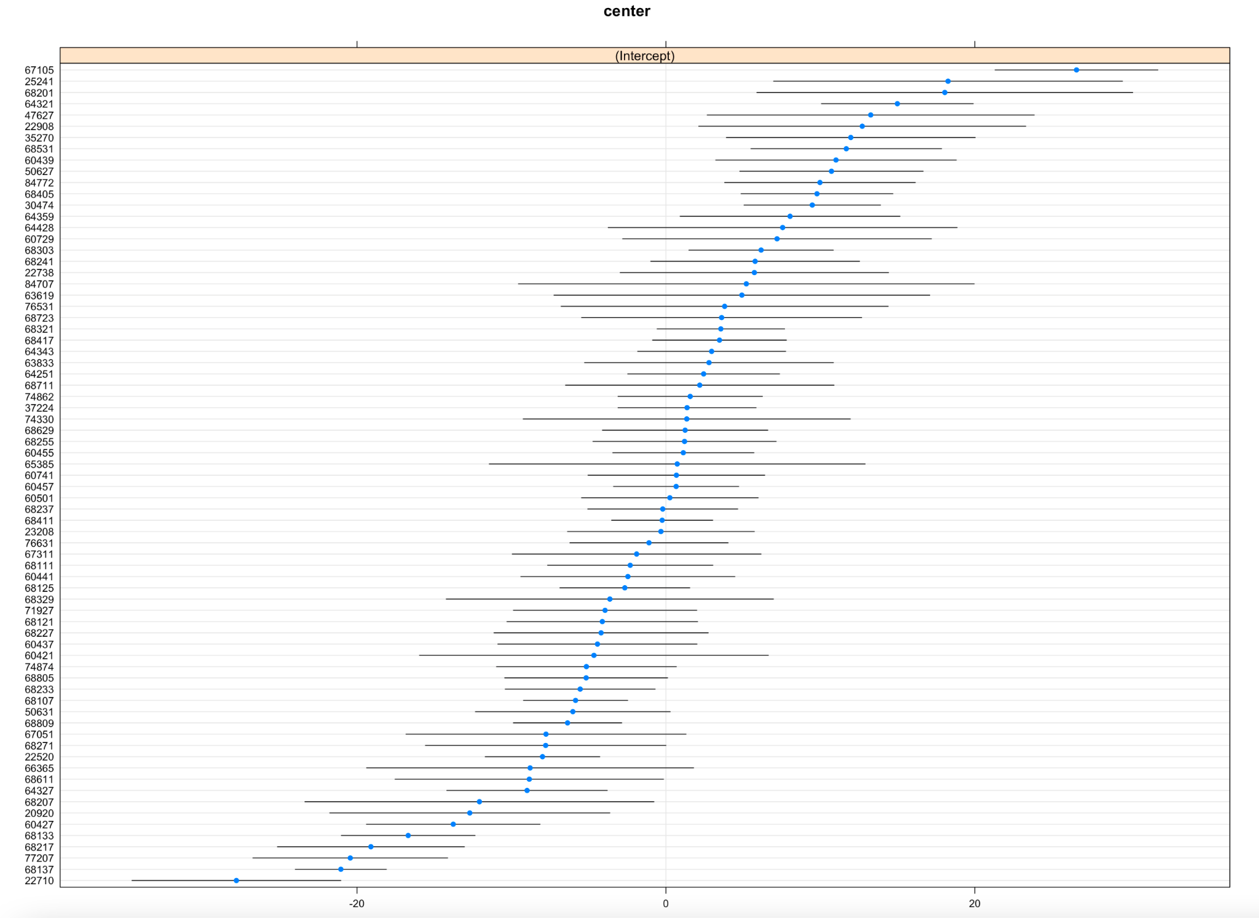
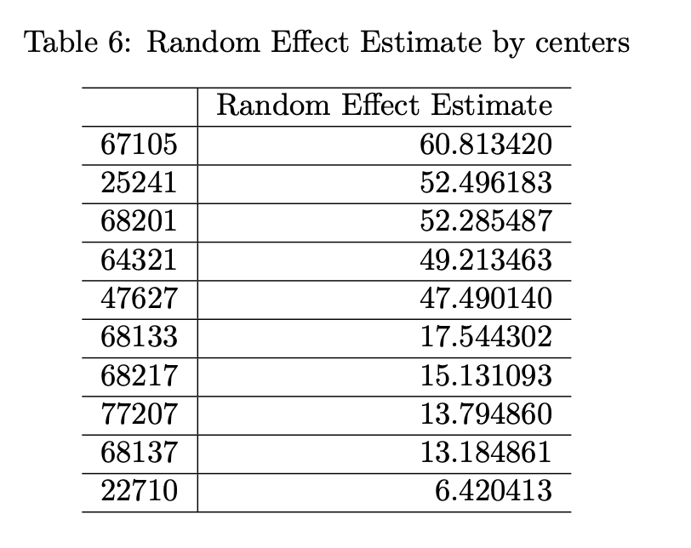
Model Results

Slide 23
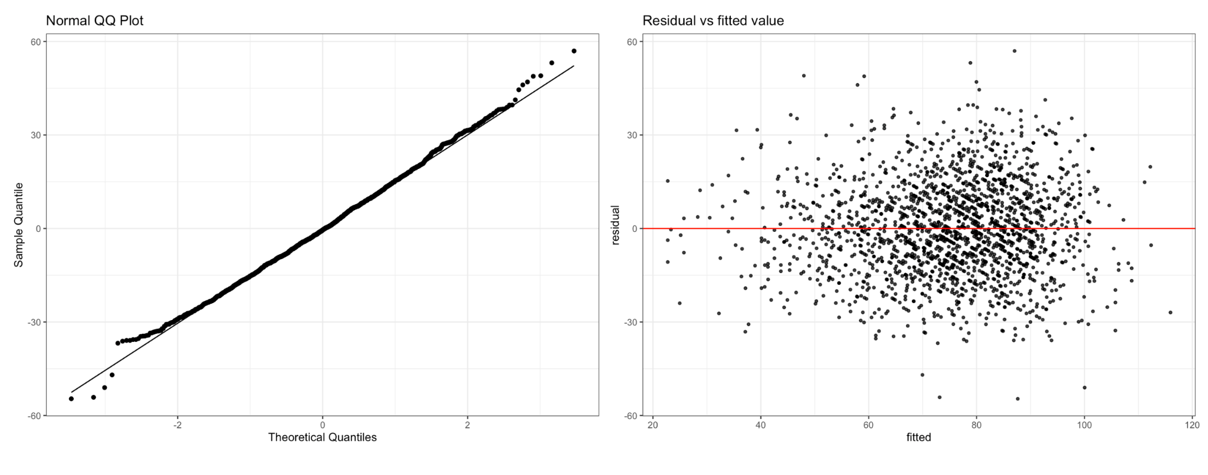
Model Assessment and Limitation

Slide 24
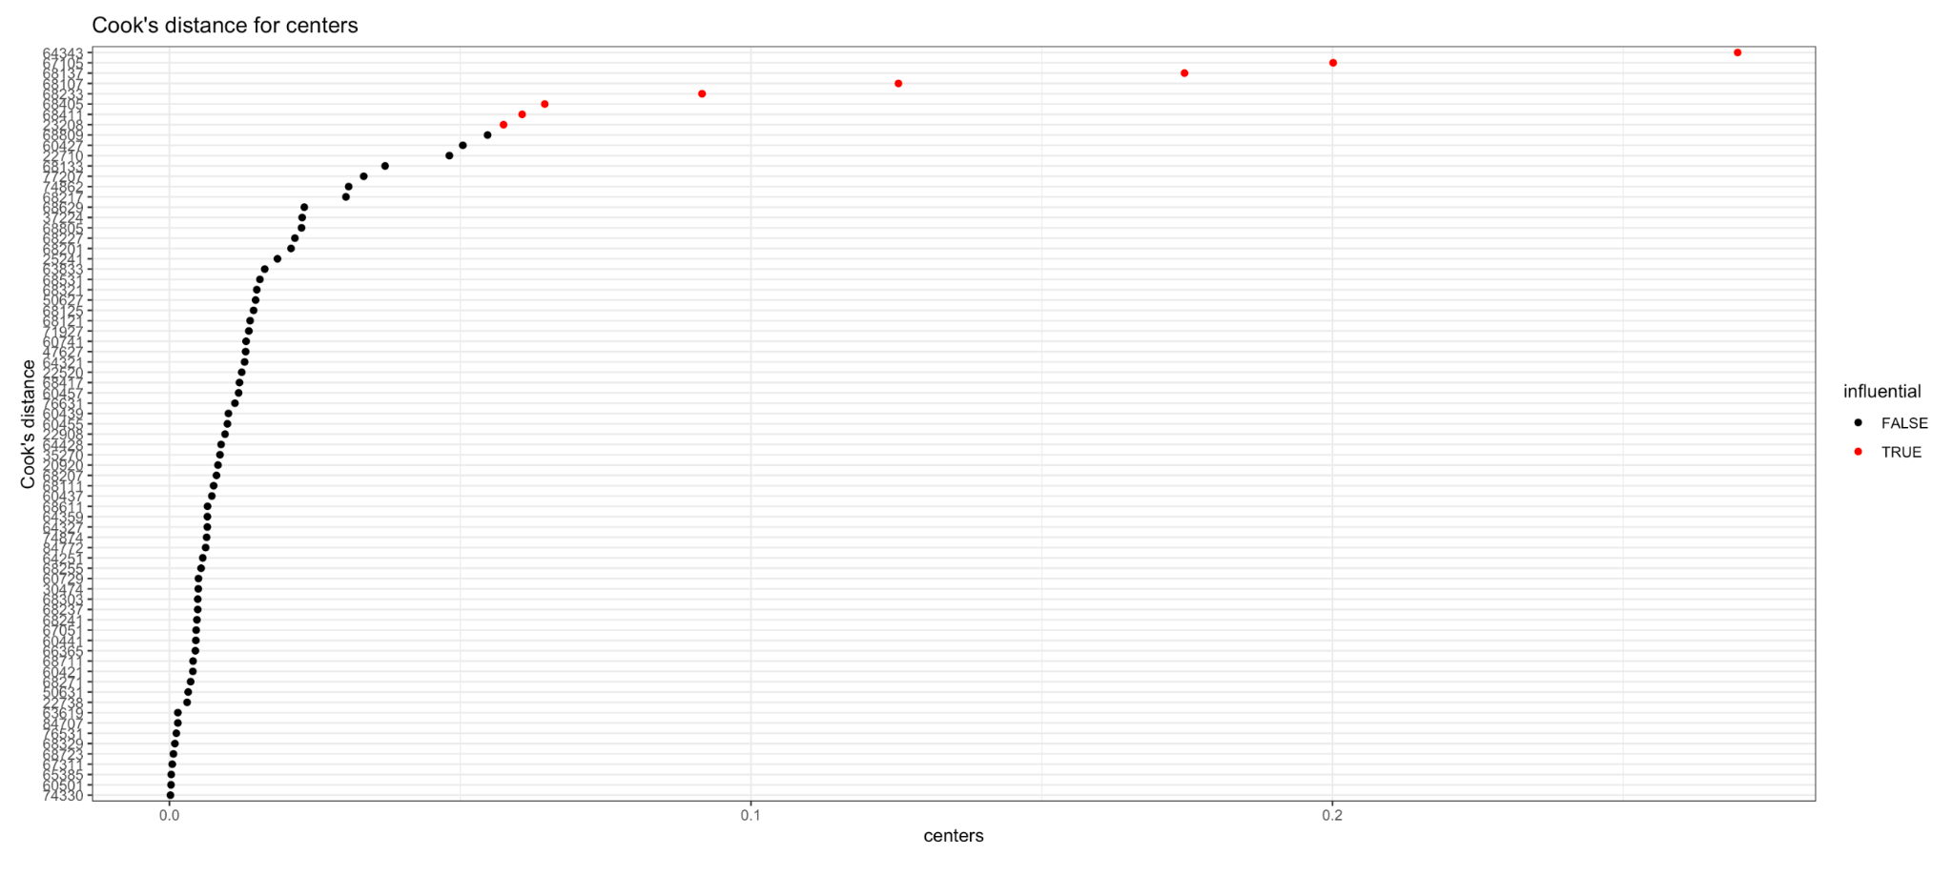
Model Assessment and Limitation

Slide 25
References
Centre for Multilevel Modelling. http://www.bristol.ac.uk/cmm/learning/support/datasets/
STA 610 Fall 2021. https://sta610-f21.olanrewajuakande.com/syllabus/

Slide 26
Thank you!

